Slide 1
ACM/ICPC 基础知识
cnHawk @ Tju_Rhythm
2006.11.24

Slide 2
ACM/ICPC考验的能力和知识
Programming experience 编程经验
(C/C++ or Java)
Mathematics 数学能力
Data Structure 数据结构
Algorithm 算法

Slide 3
讲座内容预告：
12月1日：
数据结构：栈，队列等
贪心算法及例题讲解
数学知识：组合数学等

Slide 4
如何获取信息：
推荐：BBS
http://bbs.tju.edu.cn
分类讨论区—电脑技术区—ACM国际大学生程序设计
版面内有大量学习文章、以前讲座的ppt
FTP:
ftp://acm.tju.edu.cn
用户名，密码均为acm
QQ群：
24276136

Slide 5
第一部分
Online Judge的使用
http://acm.tju.edu.cn

Slide 6
FAQs
Q: How can I start?
Q: Why did I get a Compilation Error?
Q: What is the meaning of the judge's reply?
Q: What does SIGSEGV in Runtime Error mean?

Slide 7
How to Start:
First you need to register a user, and then you may try to read some problems and submit your solution in C/C++/Pascal. The system will judge your solution, and tell you it is right or wrong.

Slide 8
How to Start:
Note that pass sample input/output does not mean your code is right, the system will test your code with some strict data, so make sure your code fits into the problem description. Your codes must read from Standard Input, and write to Standard Output. Do not try to open a file which is forbidden on Online Judge.

Slide 9
How to Start:
Your codes will be judged automatically, not manually, so no extra output needed. The input and output of your codes will be split, you may read and write alternately, but do not use printf / cout at the same time, since it may cause some error.

Slide 10
Why did I get a Compilation Error?
There are some differences between GNU GCC and MS-VC++, such as:
main must be declared as int, void main will end up with a Compilation Error.
i is out of definition after block "for(int i=0...){...}"
itoa is not an ANSI function.
int64 of VC is not ANSI, but you can use long long for 64-bit integer.

Slide 11
What is the meaning of the judge's reply?
Received : The judge system has received your solution, usually you just need to wait a minute and your solution will be judged.
Accepted (AC) : OK! Your program is correct!.
Presentation Error (PE) : Output Format Error. Your output format is not exactly the same as the judge's output, although your answer to the problem is correct. Check your output for spaces, blank lines, etc. against the problem output specification.

Slide 12
What is the meaning of the judge's reply?
Wrong Answer (WA) : Correct solution not reached for the inputs. The inputs and outputs that we use to test the programs are not public. Some problems with special judge may not reply "Presentation Error", replaced by "Wrong Answer".
Runtime Error (RE) : Your program failed during the execution (segmentation fault, floating point exception...). The exact cause is reported to the user.
Time Limit Exceeded (TLE) : Your program tried to run during too much time.

Slide 13
What is the meaning of the judge's reply?
Memory Limit Exceeded (MLE) : Your program tried to use more memory than the judge default settings.
Output Limit Exceeded (OLE): Your program tried to write too much information. This usually occurs if it goes into a infinite loop. The output limit is usually 256K, 512K, or 1M bytes.
Compilation Error (CE) : The compiler (gcc/g++/gpc) could not compile your ANSI program. Of course, warning messages are not error messages. Click the link at the judge reply to see the actual error message.

Slide 14
What is the meaning of the judge's reply?
Out Of Contest Time: this message can only appear during a contest, if a program is submitted out of contest time.
No such problem: Either you have submitted a wrong problem id or the problem is unavailable.
Restricted Function: Your program tried to call restricted functions. For example, maybe you have tried to open a file which is forbidden on OJ. It may also caused by Runtime Error (e.g. maybe a pointer point to wrong funtion), You may consider it as Runtime Error in this situation.
Internal Error: The Judge system cause a internal error, please submit it later.

Slide 15
What does SIGSEGV in Runtime Error mean?
The following messages will not be shown to you in contest. Here we just provide some tips:
SIGSEGV --- Segment Fault. The possible cases of your encountering this error are:
1.buffer overflow --- usually caused by a pointer reference out of range.
2.stack overflow --- please keep in mind that the default stack size is 8192K.
3.illegal file access --- file operations are forbidden on our judge system.
SIGFPE --- Divided by 0
SIGBUS --- Hardware Error.
SIGABRT --- Program aborted before it should be finished.

Slide 16
Input & Output Tips
严格按照题目意思确定输入输出格式

Slide 17
输入一开始有一个N,表示有N个Case,下面接着是这N个Case的具体情况:
C:
scanf(“%d”, &n);
for(i = 0; i < n; i++) {
……
}
C++:
cin>>n;
for(i = 0; i < n; i++) {
……
}

Slide 18
不说明有多少个Case,直接以某个特定的标志作为结束(比如0)
C:
while(1) {
scanf(“%d”, &n);
if(n == 0)break;
……
}
C++:
while(1) {
cin>>n;
if(n == 0)break;
……
}

Slide 19
不明确说明结束标志,或者一直要处理到end of file
C:
while( scanf(“%d %d”, &n, &m) != EOF ) {
……
}
如果是按行读入:
char str[100];
while( gets(str) != NULL ) { …… }
C++:
while( cin>>n>>m ) {
……
}

Slide 20
输出部分
一般来说，每个输出末尾都是要加空格
特殊的情况:
….. Output lines should be separated by a single blank line, but do not output any trailing blank line. (TOJ 2001)
处理方法:
int linenum = 0;
if( linenum++ )printf(“\n”);
printf(“The answer is ….\n”);

Slide 21
C/C++ Tips
数据范围：
char -128 ~ +127 (1 Byte)
short -32767 ~ + 32768 (2 Bytes)
unsigned short 0 ~ 65536 (2 Bytes)
int -2147483648 ~ +2147483647 (4 Bytes)
unsigned int 0 ~ 4294967295 (4 Bytes)
long 同int
long long -9223372036854775808 ~
+9223372036854775807 (8 Bytes)
double 1.7 * 10^308 (8 Bytes)
1，一般不需要用long
2，浮点数一律使用double，不要用float

Slide 22
第二部分
Complexity Analysis
复杂度分析

Slide 23
复杂度
时间复杂度:程序的执行步数
执行了多少次基本操作
空间复杂度:程序占用的内存
堆栈空间与变量空间

Slide 24
示例1:查找数组a中的最大值
int max;
for(i = 0; i < n; i++){
if(a[i] > max) max = a[i];
}

Slide 25
示例2: 冒泡排序
for(i = 0; i < n; i++){
for(j = 0; j < n-i-1; j++){
if(a[j] < a[j+1]){
swap(a[j], a[j+1]);
}
}
}

Slide 26
渐近分析,符号(О,Ω,Θ)
计算机科学使用最多的符号-讨论算法时使用的共同语言.
f(n)=O(g(n)) iff 存在正常数c和n₀使得对所有n>n₀ 有f(n)<cg(n) 成立.
Lim_{n->∞}f(n)/g(n)=c, 0≤c<∞,则
f(n)=O(g(n))

Slide 27
10n²+3n+100=O(n²),lim=10;
1000n²=O(n^{2.1}),lim=0
称g(n)为f(n)的渐近上界(Asymptotic Upper Bound).
约定O(1)代表常数.
g(n)常取一些简单的初等函数,n^{k},log₂n
和n^{k}log₂n等:

Slide 28
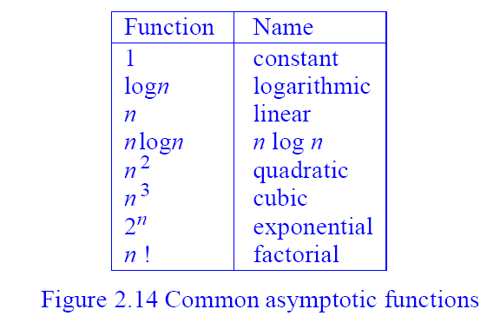

Slide 29
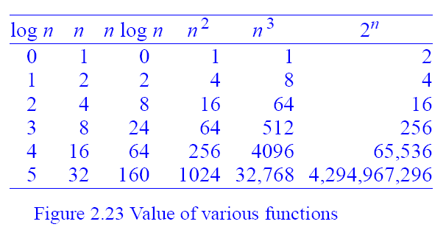
Can a Algorithm work with large input ?

Slide 30
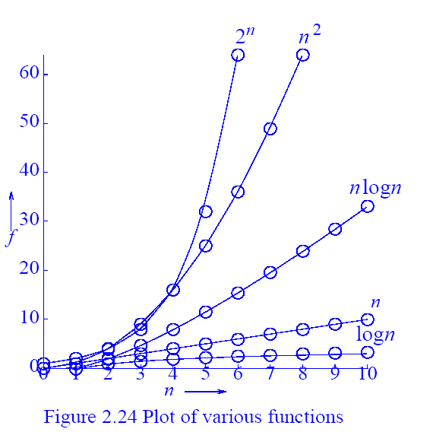
渐近分析-随n的增加T(n)的增长率

Slide 31
补充一下: 如何排序
#include <algorithm>
using namespace std;
对数组a[N]进行从小到大排序:
sort(a, a+N);

Slide 32
Algorithm
sort()
void sort(RandomAccessIterator first, RandomAccessIterator last);
void sort(RandomAccessIterator first, RandomAccessIterator last, StrictWeakOrdering comp);
区间[first,last)
Quicksort,复杂度O(nlogn)
(n=last-first,平均情况和最坏情况)

Slide 33
Algorithm
用法举例:
1.从小到大排序(int, double, char, string, etc)
const int N = 5;
int main()
{
int a[N] = {4,1,2,5,3};
string str[N] = {“YES”,”NO”,”C++”,”TJU”,”BBS”};
sort(a,a+N);
sort(str,str+N);
return 0;
}

Slide 34
Algorithm
2.从大到小排序（需要自己写comp函数)
const int N = 5;
int cmp(int a,int b) {return a > b;}
int main()
{
int a[N] = {4,1,2,5,3};
sort(a,a+N,cmp);
return 0;
}

Slide 35
Algorithm
3. 对结构体排序
struct SS {int first,second;};
int cmp(SS a, SS b) {
if (a.first != b.first) return a.first < b.first;
return a.second < b.second;
}
v.s. qsort() in C (平均情况O(nlogn)，最坏情况O(n^2))
int cmp(const void *a, const void *b) {
if (((SS*)a)->first != ((SS*)b)->first)
return ((SS*)a)->first – ((SS*)b)->first;
return ((SS*)a)->second – ((SS*)b)->second;
}
qsort(array,n,sizeof(array[0]),cmp);

Slide 36
Algorithms are the rhythms of computer science.
可以说,ACM/ICPC的核心内容就是对算法的考察,而复杂度理论就是用于评价算法的优劣.

Slide 37
What’s more…
充分利用资源:BBS, Baidu, Google
从简单题慢慢开始:
1939.1730.1476.1169.2051.1574.1818.2056.1748.1412.
1649.1015.1715.1457.1823.1233.1805.1380.1257.1549.
1637.1833.1355.1208.1516.2076.1154.2010.1517.1171.
1856.1477.2483.2468.

Slide 38
Thank you!

